Slide 1
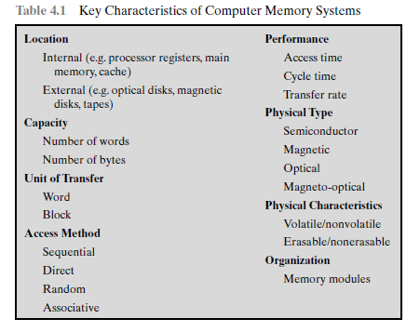
Computer memory system
time it takes to perform a read or write operation, that is, the time from the instant that an address is presented to the memory to the instant that data have been stored or
made available for use.
Characteristics of memory system
This is the rate at which data can be transferred into or out of a memory unit.
Internal memory is often equated with main memory
consists of the access time plus any additional time required before a
second access can commence.
Volatile memory, information decays naturally or is lost when electrical power is switched off.
information once recorded remains without deterioration
until deliberately changed
unit of transfer is equal to the number of electrical lines into and out of the memory module.
Access must be made in a specific linear sequence.
Nonerasable memory cannot be altered, except by destroying
the storage unit.
any location can be selected at random and directly addressed and accessed
Make a comparison of desired bit locations within a word for a specified match, and to do this for all words simultaneously

Slide 2
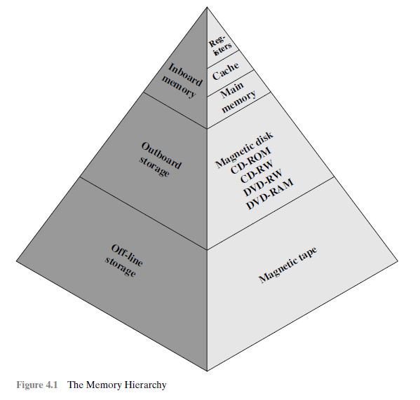
The Memory Hierarchy
following relationships hold during implementations of memory systems :
• Faster access time, greater cost per bit
• Greater capacity, smaller cost per bit
• Greater capacity, slower access time
As one goes down the hierarchy, the following occur:
a. Decreasing cost per bit
b. Increasing capacity
c. Increasing access time
d. Decreasing frequency of access of the memory by the processor

Slide 3
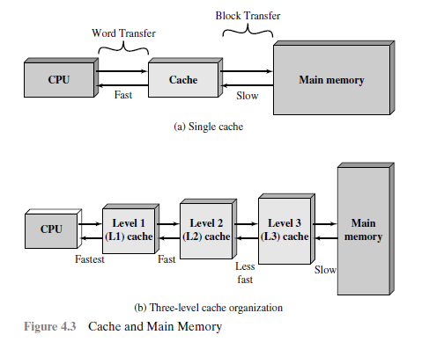
CACHE MEMORY PRINCIPLES
The cache contains a copy of portions of main memory
If not, a block of main memory, consisting of some fixed number of words, is read into
the cache and then the word is delivered to the processor
processor attempts to read a word of memory
,a check is made to determine if the word is in the cache If so, the word is delivered to the processor
The L2 cache is slower and typically larger than the L1 cache, and the L3 cache is slower and typically
larger than the L2 cache

Slide 4
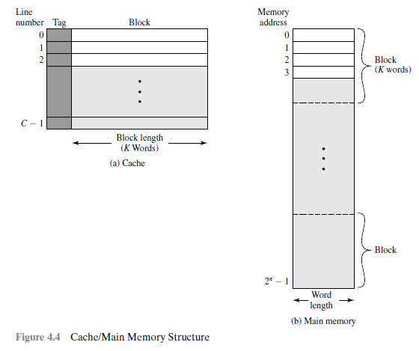
consists of m blocks, called lines.
line also includes control bits to indicate line has been modified since being loaded into the cache
tag that identifies which block is currently being stored.
Tag is a portion of the main memory address and lines less than main memory blocks
The length of a line, not including tag and control bits
For mapping purposes, consist of a number of fixed length blocks of K words
If a word read, that block is transferred to one of the lines of the cache. But not uniquely and permanently dedicated to a particular block
Each line contains K words, plus a tag of a few bits..
consists of up to 2n addressable words, with each word having a unique n-bit address

Slide 5
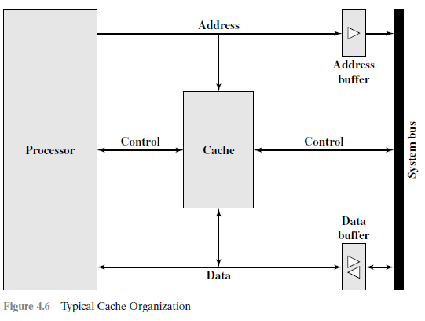
When a cache hit
address is loaded onto the system
bus
When a cache miss occurs

Slide 6
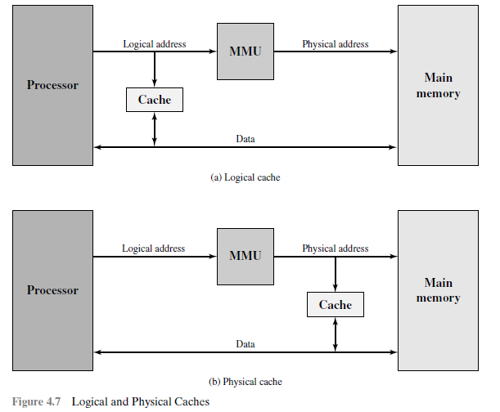
ELEMENTS OF CACHE DESIGN
Cache Addresses
virtual memory address memory from a logical point of view,
For reads to and writes from main memory, a hardware memory management unit (MMU) Translates each virtual address into a physical address in main memory.
supply same virtual memory address space. So each application sees a virtual memory that starts at address 0.
The cache memory must flushed with each application context switch, or extra bits must be added to each line of the cache .
A logical cache,also known as a virtual cache, stores data using virtual addresses. The processor accesses the cache directly, without going through the MMU
A physical cache stores data using main memory physical Addresses
logical cache access speed is faster than for a physical cache, because the cache can respond before the MMU performs an address translation.

Slide 7
Cache Size
size of the cache to be small enough so that ,
the overall average cost per bit is close to that of main memory alone
and large enough so that the overall average access time is close to that of the cache alone.
The larger the cache, the larger the number of gates involved in addressing the cache.
The result is that large caches tend to be slightly slower than small caches
The available chip and board area also limits cache size.

Slide 8
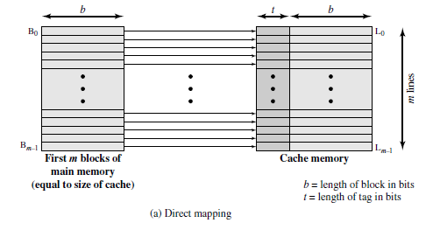
Mapping Function
block Bm of main memory maps into line L0 of cache, block Bm+1 maps into line L1, and so on.
mapping function dictates how the cache is organized.Three techniques
can be used:
direct, associative, and set associative.
DIRECT MAPPING
maps each block of main memory into only one possible cache line.
The mapping is expressed As
i = j modulo m
where
i = cache line number
j = main memory block number
m =number of lines in the cache
Each block of main memory maps into one unique line of the cache.

Slide 9
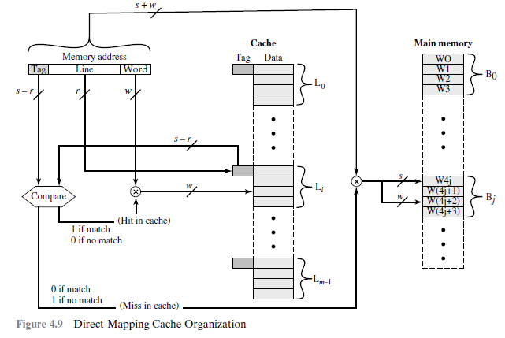
Continued…

Slide 10
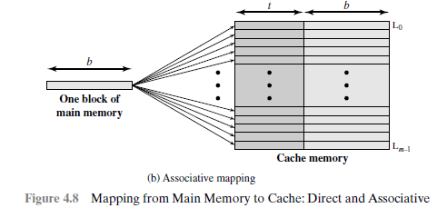
ASSOCIATIVE MAPPING
overcomes the disadvantage of direct mapping
main memory block to be loaded into any line of the cache
the cache control logic interprets a memory address simply as a Tag and a Word field.
The Tag field uniquely identifies a block of main memory.
To determine whether a block is in the cache, the cache control logic must simultaneously examine every line’s tag for a match.

Slide 11
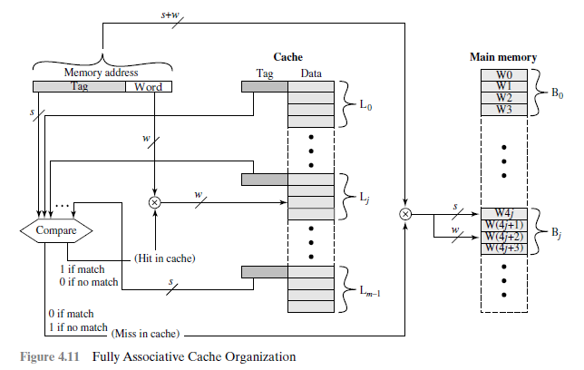
Continued…

Slide 12
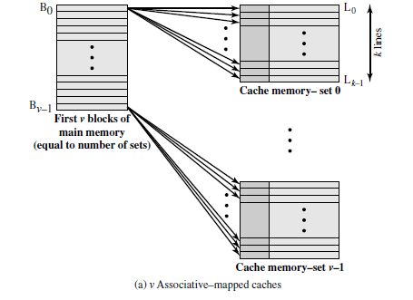
SET-ASSOCIATIVE MAPPING
Set-associative mapping is having the strengths of both the direct and associative approaches
In this case, the cache consists of a number sets, each of which consists of a no of lines
relationships are
m = V * k
i = j modulo K
where
I = cache set number
j =main memory block number
M= number of lines in the cache
V=number of sets
K= number of lines in each set
Each word maps into all the cache lines in a specific set
that main memory block B0 maps into set 0, and so on

Slide 13
Replacement Algorithms
If cache filled,and new block is brought into the cache, one existing blocks must be replaced. For direct mapping it is easy.
For the associative and set associative, a replacement algorithm implemented in hardware.
least recently used (LRU):
Replace that block in the set that has been in the cache longest with no reference to it.
Each line includes a USE bit.
When a line is referenced, its USE bit is set to 1 and the USE bit of the other line in that set is set to 0.
When a block is to be read into the set, the line whose USE bit is 0 is used
first-in-first-out (FIFO): Replace that block in the set that has been in the cache longest. implemented as a round-robin or circular buffer technique.
least frequently used (LFU): Replace that block in the set that has experienced the fewest references. Implemented by associating a counter with each line.

Slide 14
Write Policy
There are two problems
First, more than one device may have access to main memory. Either memory or cache is invalidated.
when multiple processors has its own local cache. word is altered in one cache, it invalidate other caches
write through:- all write operations are made to main memory and cache, ensuring that main memory is always valid. Other monitor traffic for consistency in within its own cache.
write back, minimizes memory writes. updates in the cache. Makes dirty bit, or use bit, associated with the line is set. when a block is replaced, written back to main memory if dirty bit is set.
cache coherency include the following:
Bus watching with write through:
Each cache controller monitors the address lines to detect write operations to memory, if other wants to write in cache the cache controller invalidates that cache entry.
Hardware transparency:
Additional hardware is used to ensure that all updates to main memory via cache are reflected in all caches.
Non-cacheable memory:
Only a portion of main memory is shared by more than one processor, and this is designated as non-cacheable.

Slide 15
Line Size
When data is retrieved and placed in the cache, desired word also adjacent words are retrieved.
As the block size increases, the hit ratio will increase due to more useful data are brought into the cache.
The hit ratio will decrease, block becomes even bigger and reusability of data is increased than fetching new data.
.Two specific effects come into play:
• Larger blocks reduce the number of blocks that fit into a cache.
• As a block becomes larger, each additional word is less likely to be needed in the near future.

Slide 16
Number of Caches
Two aspects of this design
issue concern the number of levels of caches and the use of unified versus split caches
MULTILEVEL CACHES
the on-chip cache reduces the processor’s external Activity. speeds up execution and performance.
bus access is eliminated. Because of the short data paths internal to the processor.
zero-wait state bus cycles. And the bus is free to support other transfers.
If no two caches then processor request to single cache so bus speed is reduced.
UNIFIED VERSUS SPLIT CACHES
to split the cache into two: one dedicated to instructions and one dedicated to data.
When the processor fetch an instruction from main memory, it first consults the instruction L1 cache, and when the processor fetch data from main memory, it first consults the data L1 cache.
advantages of a unified cache:
has a higher hit rate than split caches because balances the load between instruction and data fetches automatically.
Only one cache needs to be designed and implemented

Slide 17
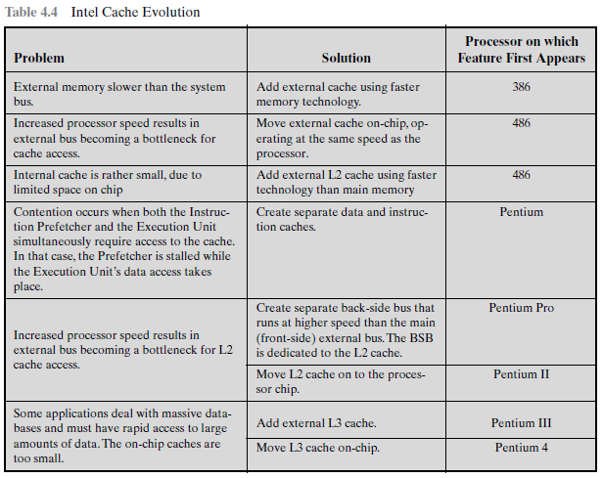
PENTIUM 4 CACHE ORGANIZATION

Slide 18
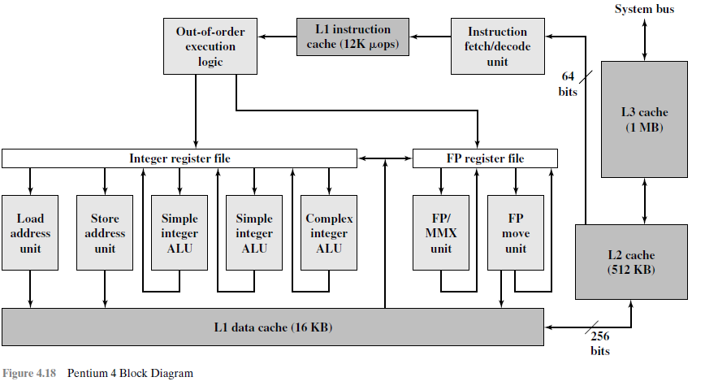
Schedules execution of the micro-operations subject to data dependencies and resource availability
Fetches program instructions from the L2 cache, decodes into a series of micro-operations, and stores the results in the L1 instruction cache.
These units executes micro-operations, fetching the required data from the L1 data cache and temporarily storing results in registers.
used to access main memory when the L1 and L2 caches have a cache miss and to access the system I/O resources.

Slide 19
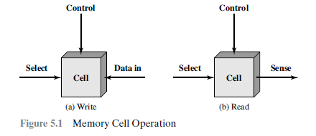
INTERNAL MEMORY
SEMICONDUCTOR MAIN MEMORY
Organization
The basic element is the memory cell.
For reading, that terminal
is used for output of the cell’s state.
The select terminal, as the name suggests, selects a memory cell for a read or write operation.
The control terminal indicates read or write. For writing, the other terminal provides
an electrical signal that sets the state of the cell to 1 or 0

Slide 20
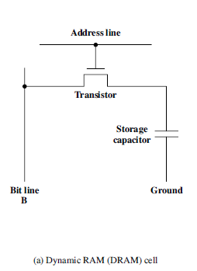
DRAM and SRAM
RAM read data from the memory and to write new data into the memory accomplished through the use of electrical signals.
it is volatile. constant power supply. If the power is interrupted, then the data are lost
DYNAMIC RAM
made with cells that store data as charge on capacitors.The presence or absence of charge in a capacitor is interpreted as a binary 1 or 0.
. The readout from the cell discharges the capacitor, which must be restored to complete the operation
For the read operation, address line is selected
then applied to the address line, allowing a charge to be transferred to the capacito
acts as a switch that is closed (allowing current to flow) if a voltage is applied to the address line and open (no current flows)
charge stored on the capacitor is fed out onto a bit line and to a sense
amplifier.
For the write operation, a voltage applied to bit line; 1, 0 states as per high and low
the transistor turns on
The sense amplifier compares the capacitor voltage to a reference value and determines if a logic 1 or 0
stores 1 bit.
activated when the bit value from this cell is to be read or written.

Slide 21
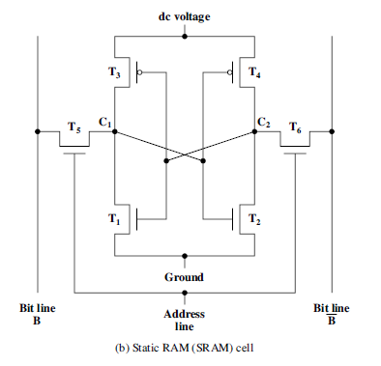
STATIC RAM
binary values are stored using traditional flip-flop logic-gate configurations
hold its data as long as power is supplied to it.
In logic state 1, point C1 is high and point C2 is low; in this state,T1 and T4 are off and T2
and T3 are on.
In logic state 0, point C1 is low and point C2 is high; in this state,T1 and
T4 are on and T2 and T3 are off
Transistors are cross connected and produces a stable logic state.
1
0
0
1
When a signal is applied to this line, the two transistors are switched on, allowing a read or write operation
write operation, the desired bit value is applied to line B, while its complement is applied to line B bar .
This forces the four transistors (T1, T2, T3, T4) into the proper state.
For a read operation, the bit value is read from line B.
address line is used to open or close a switch.
The address line controls two transistors (T5 and T6).

Slide 22
Types of ROM
read-only memory (ROM)
contains a permanent pattern of data that cannot be changed.
A ROM is nonvolatile; that is, no power source is required
to maintain the bit values in memory. not possible to write new data into it
Data permanently in main memory and need never be loaded from a secondary storage device
programmable ROM (PROM).
nonvolatile and may be written into only once. writing process is performed electrically
erasable programmable read-only memory (EPROM)
is read written electrically, as with PROM. before a write operation, all the storage cells must be erased by exposure of the packaged chip to ultraviolet radiation
electrically erasable programmable
read-only memory (EEPROM ).
be written into at any time without erasing prior contents;
flash memory
uses an electrical erasing technology.
An entire flash memory can be erased in one or a few seconds,
it is possible to erase just blocks of memory rather than an entire chip.

Slide 23
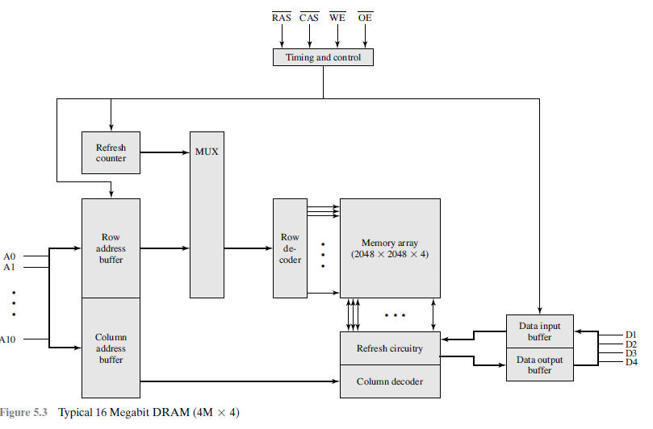
Chip Logic
11 address signals are passed to the
chip to define the row address of the array, and then the other 11 address signals are presented for the column address
row address select and column address select signals to provide timing to the chip.
The write enable and output enable pins determine whether a write or read operation is performed
multiplexed addressing plus the use of square arrays result in a
quadrupling of memory size with each new generation of memory chips
Each horizontal line connects to the Select terminal of each cell in its row
Address lines supply the address of the word to be selected
memory array is organized as four square arrays of 2048 by 2048 elements. Various physical arrangements are possible
vertical line connects to the Data-In/Sense terminal of each cell in its column.
Four data lines are used for the input and output of 4 bits to and from a data buffer
The logic of the decoder activates a single one of the 2048 outputs depending on the bit pattern on the 11 input lines

Slide 24
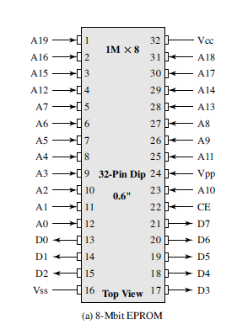
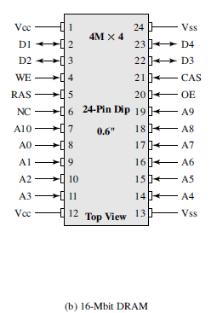
Chip Packaging
The power supply to the chip (Vcc).
The write enable (WE) and output enable (OE) pins indicate whether this is a write or read operation
The address of the word being accessed
program voltage (Vpp) that is supplied during programming (write operations).
CE pin is used to indicate whether or not the address is valid for this chip
The data to be read out, consisting of 8 lines
A ground pin (Vss).

Slide 25
Interleaved Memory
Chips grouped together to form a memory bank.
organize the memory banks in a way known as interleaved memory
.
Each bank is to service a memory read or write request,
so that K banks can service K requests simultaneously,
increasing memory read or write rates by a factor of K.

Slide 26
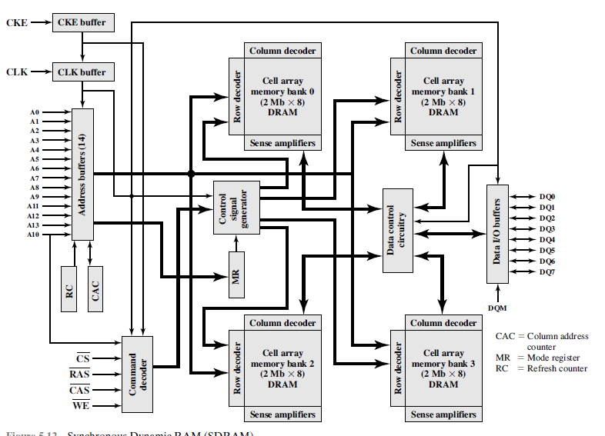
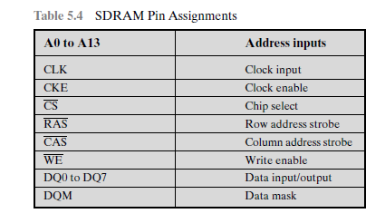
ADVANCED DRAM ORGANIZATION
Synchronous DRAM
exchanges data with the processor synchronized to an external clock signal and running at the full speed of the processor/memory bus without imposing wait states
employs a burst mode to eliminate the address setup time and row and column line pre charge time after the first access
has a multiple-bank internal architecture that improves opportunities for on-chip parallelism.
The register also allows the programmer to adjust the latency between receipt of a read request and the beginning of data transfer.
transferring large blocks of data serially, in applications like word processing, spreadsheets, and multimedia
The mode register specifies the burst length, which is the number of separate units of data synchronously fed onto the bus.

Slide 27
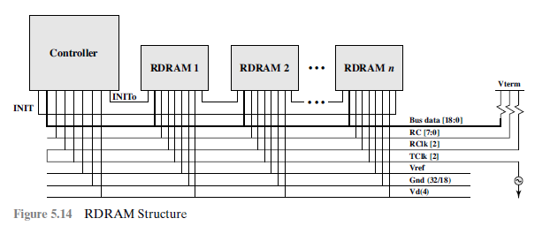
Rambus DRAM
The chip exchanges data with the processor over 28 wires no more than 12 centimeters long.
The bus can address up to 320 RDRAM chips and is rated at 1.6 GBps.
delivers address and control information using an asynchronous block-oriented protocol
defines impedances, clocking, and signals very precisely.
request contains the desired address, the type of operation, and the number of bytes in the operation
gets a memory request over the high-speed bus
vertical packages, with all pins on one side.
used for address and control signals.
clock signal
propagates to the controller end and then loops back
reference voltage, ground, and
power source

Slide 28
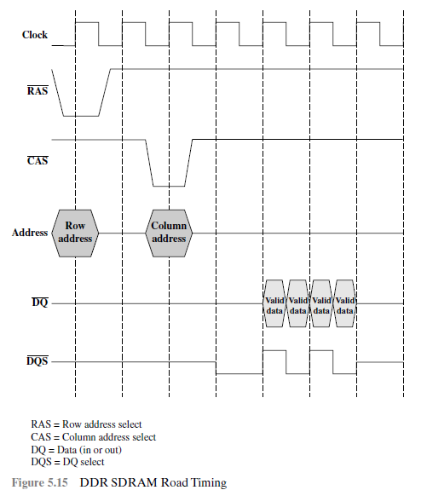
DDR SDRAM
can send data twice per clock cycle, once on the rising edge of the clock pulse and once on the falling edge
It is also synchronized to a bidirectional data strobe (DQS) signal that is
provided by the memory controller during a read and by the DRAM during a write.

Slide 29
Cache DRAM
Integrates a small SRAM cache (16 Kb) onto a generic DRAM chip.
First, it can be used as a true cache, consisting of a number of 64-bit lines.
effective for ordinary random access to memory.
used as a buffer to support the serial access of a block of data.

Slide 30
External Memory- Hard Disk organization
circular platter constructed of nonmagnetic material, called the substrate, coated with a magnetizable material.
Traditionally, the substrate has been an aluminum or aluminum alloy material.
More recently, glass substrates have been introduced
glass substrate has a number of benefits
• Improvement in the uniformity of the magnetic film surface to increase disk
reliability
• A significant reduction in overall surface defects to help reduce read-write errors
• Ability to support lower fly heights (described subsequently)
• Better stiffness to reduce disk dynamics
• Greater ability to withstand shock and damage

Slide 31
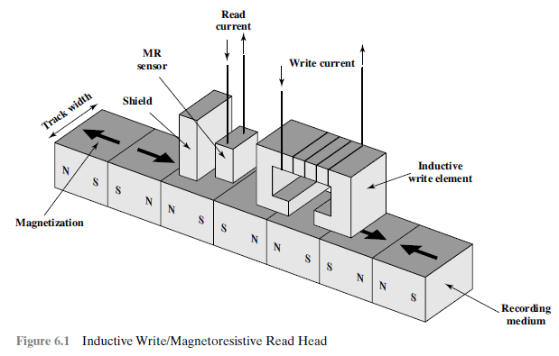
Magnetic Read and Write Mechanisms
Data are recorded and retrieved from the disk via a conducting coil named the head
a read head and a write head.
head is stationary while the platter rotates beneath it.
electricity flowing through a coil produces a magnetic field.
Electric pulses are sent to the write head, and the resulting magnetic patterns are recorded on the surface below, with different patterns for positive and negative currents
shielded magnetoresistive (MR) sensor.The MR material
has an electrical resistance that depends on the direction of the magnetization of the
medium moving under it
read head, close to the write head.
write head magnetizable material and shape of a rectangular doughnut with a gap along one side and a few turns of conducting wire along the opposite side
passing a current through MR sensor, resistance changes are detected as voltage signals.
electric current in the wire induces a magnetic field across the gap,
Reversing direction of the current reverses the magnetization on the recording medium
The MR design allows higher-frequency operation, which equates to greater storage densities and operating speeds.
which in turn magnetizes a small area of the recording medium.

Slide 32
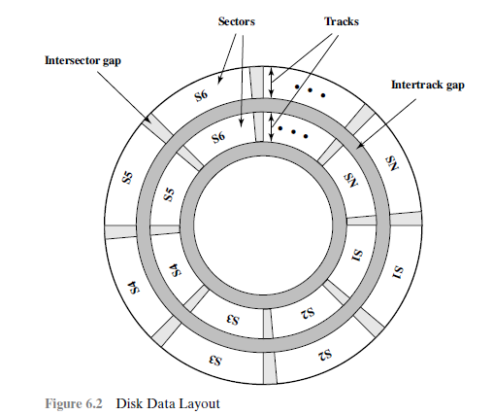
Data Organization and Formatting
adjacent sectors are separated by intratrack (intersector) gaps minimizes, errors due to misalignment of the head
.Data are transferred to and from the disk in sectors (fixed or variable length.)
platter in a concentric set of rings, called tracks. same width as the head.

Slide 33
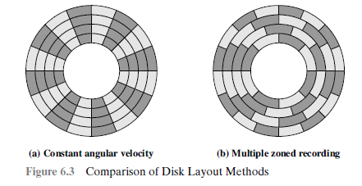
Continued…
The information scanned at the same rate by rotating the disk at a fixed speed, known as the constant angular velocity (CAV).
To increase density in which the surface is divided into a number of concentric zones
To move the head only takes a short movement of the head to a specific track & wait for the proper sector to spin under the head
disk storage capacity is limited
Zones farther from the center contain more bits (more sectors) than zones closer to the center.
number of pie-shaped sectors and into a series of concentric tracks.CAV is that individual blocks of data can be directly addressed by track and sector

Slide 34
Physical Characteristics
characteristics that differentiate among the various types of magnetic disks.
Head fixed or movable with respect to the radial direction of the platter.
In a fixed-head disk, there is one read-write head per track.
All of the heads are mounted on a rigid arm that extends across all tracks;
In a movable-head disk, there is only one read-write head. Again, the head is mounted on an arm.
The disk mounted in a disk drive, which consists of the arm, a spindle ,that rotates the disk, and the electronics needed for input and output of binary data.
The hard disk in a personal computer is a nonremovable disk which is permanently mounted in the disk drive
A removable disk can be removed and replaced with another disk. E.g, Floppy disks and
magnetizable coating is applied to both sides of the platter, which is then referred to as double sided.

Slide 35
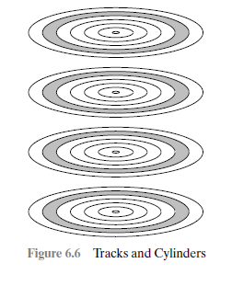
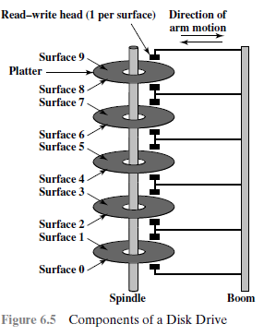
Some disk drives accommodate multiple platters stacked vertically a fraction of an inch apart.
The set of all the tracks in the same relative position on the platter is referred to as a cylinder. For example, all of the shaded tracks.

Slide 36
RAID- level 1 to level 6
single I/O request can be executed in parallel if the block of data to be accessed is distributed across multiple disks
multiple-disk database design, known as RAID (Redundant Array of Independent Disks).
consists of seven levels share three common characteristics:
1. RAID is a set of physical disk drives viewed by the operating system as a single
logical drive.
2. Data are distributed across the physical drives of an array in a scheme known as
striping, described subsequently
.
3. Redundant disk capacity is used to store parity information, which guarantees
data recoverability in case of a disk failure.

Slide 37
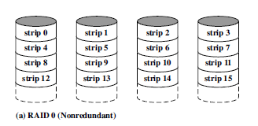
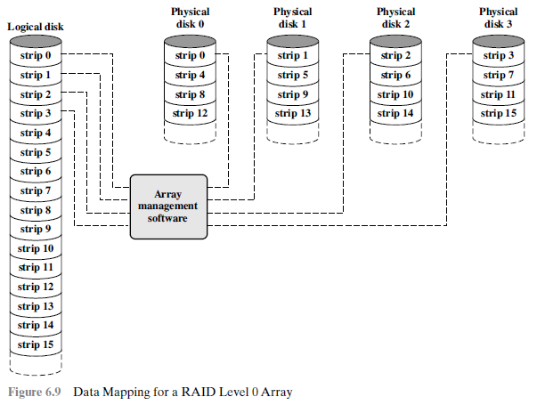
RAID 0
data are distributed across all of the disks in the array.
two requests in parallel, reducing the I/O queuing time.
The data are striped across the available disks user and system data are viewed
as being stored on a logical disk. which divided into strips; The strips are mapped round robin to consecutive physical
strips that maps exactly one strip to each array member is referred to as a stripe single I/O request
consists of multiple logically contiguous strips, then up to n strips for that request
can be handled in parallel, greatly reducing the I/O transfer time.

Slide 38
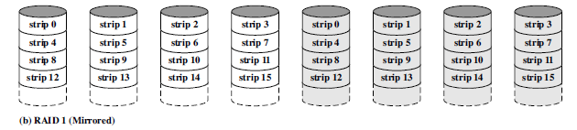
RAID Level 1
redundancy is achieved by duplicating all the data
data striping is used, each logical strip is mapped to two separate physical disks
so that every disk in the array has a mirror disk that contains the same data
positive aspects to the RAID 1 organization:
1. A read request serviced by either of the two disks that contains the requested data, whichever one involves the minimum seek time plus rotational latency
.
2. A write request requires that both corresponding strips be updated, but this can
be done in parallel. However, there is no “write penalty” with RAID 1.
3. Recovery from a failure is simple.When a drive fails, the data may still be accessed
from the second drive.

Slide 39
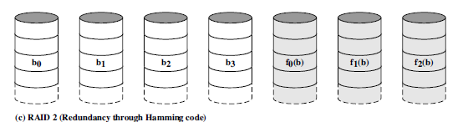
RAID Level 2
parallel access technique.
all member disks participate in the execution of every I/O request.
With RAID2, an error-correcting code is calculated across their bits on each data disk,
and the bits of the code are stored in the corresponding bit positions on multiple parity disks.
Typically, a Hamming code is used, which is able to correct single-bit
errors and detect double-bit errors.

Slide 40
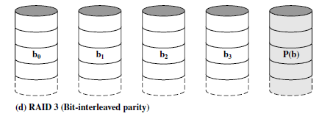
RAID Level 3
requires only a single redundant disk, no matter how large the disk array. RAID 3
employs parallel access, with data distributed in small strips. Instead of an error-correcting code, a simple parity bit is computed for the set of individual bits in the same
position on all of the data disks.
If disk failure, all of the data are still present in reduced mode.

Slide 41
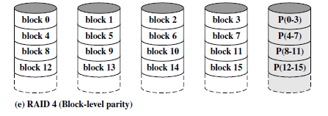
RAID Level 4
independent access technique. In an independent
access array, each member disk operates independently, so that separate
I/O requests can be satisfied in parallel. suitable for applications that require high I/O request rates and are relatively less suited for applications that require high data transfer rates.
across corresponding strips on each data disk, and the parity bits are stored
in the corresponding strip on the parity disk.
RAID 4 involves a write penalty when an I/O write request of small size is performed.
Each time that a write occurs, the array management software must update
not only the user data but also the corresponding parity bits.
To calculate the new parity, the array management software must read the old
user strip and the old parity strip. Then it can update these two strips with the new
data and the newly calculated parity. Thus, each strip write involves two reads and
two writes.

Slide 42
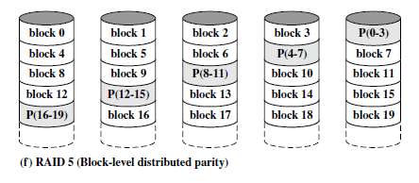
RAID Level 5
RAID 5 is organized in a similar fashion to RAID 4.The difference is that RAID 5
distributes the parity strips across all disks. A typical allocation is a round-robin
scheme, as illustrated in Figure 6.8f. For an n-disk array, the parity strip is on a different
disk for the first n stripes, and the pattern then repeats.
The distribution of parity strips across all drives avoids the potential I/O bottleneck
found in RAID 4.

Slide 43
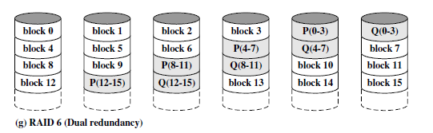
RAID Level 6
two different parity calculations are carried out
and stored in separate blocks on different disks. Thus, a RAID 6 array whose user data require N disks consists of N + 2 disks.
P and Q are two different data check algorithms.
One of the two is the exclusive-OR calculation used in RAID 4 and 5.
But the other is an independent data check algorithm.This makes it possible to regenerate
data even if two disks containing user data fail.
The advantage of RAID 6 is that it provides extremely high data availability.
Three disks would have to fail within the MTTR (mean time to repair) interval to
cause data to be lost. On the other hand, RAID 6 incurs a substantial write penalty,
because each write affects two parity blocks.

